Slide 1


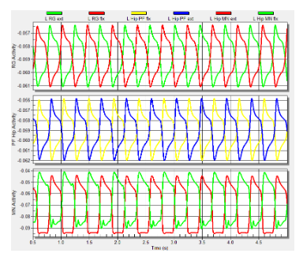
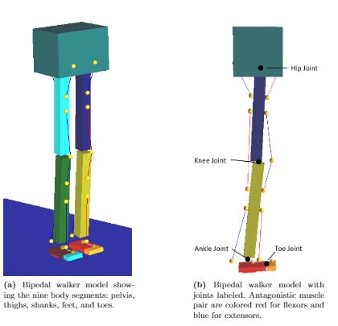
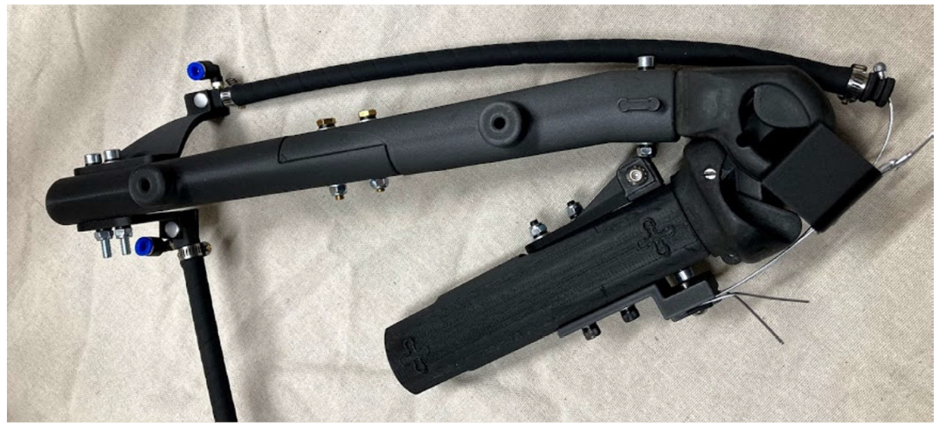
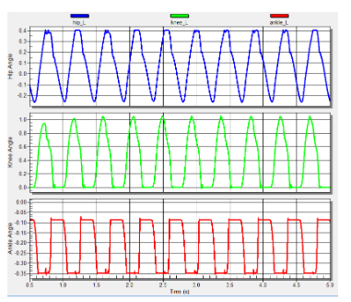
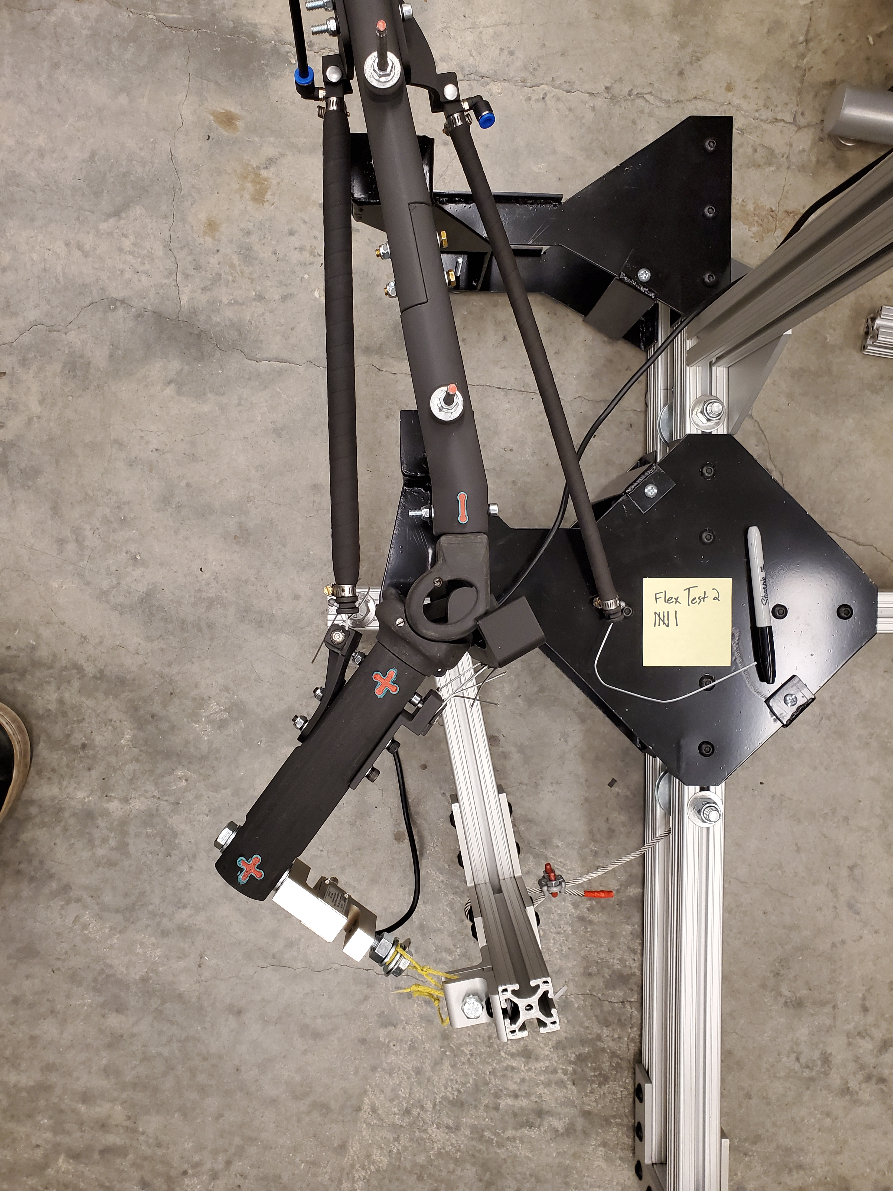
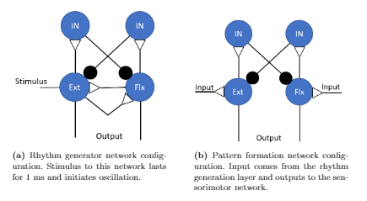
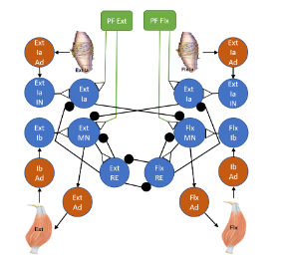
Torque Values About Artificial Knee Using
Braided Pneumatic Actuators
Ben Bolen¹, Alexander Hunt¹
1) Dept. of Mechanical and Materials Engineering, Portland State University, Portland, OR
Abstract
Neural control of locomotion is a complex process of sensing, processing, and acting that is not well understood. Greater understanding necessitates modeling biomechanics and neural circuits, and investigating how interactions between the nervous system, the body, and the environment result in effective movement and behaviors. Some of our previous work has been to design, from a biomechancial and engineering design approach, a bipedal biomimetic humanoid robot that is actuated by Festo-brand braided pneumatic actuators (BPAs) artificial muscles. BPAs can be used as artificial muscles because they have force-length curves grossly similar to real muscle. In our current work we build part of that robot (the knee, femur, and tibia), with uniarticular knee flexor and extensor BPAs, to test for the maximum isometric torque about the knee joint at various knee positions. However, previous experiments have only fully characterized the 10 mm diameter Festo BPA. Since our design uses 20 and 40 mm diameter Festo BPAs, we thought it important to fully characterize these BPA sizes and the results are included in this work. We compare the measured isometric torque values about the knee joint to the expected results, and discuss any deviation of the results. The results of these experiments help in better modeling and designing biomimetic humanoid robots. Future work will integrate these robots with neural controllers and feedback. Much of this current work revolves around humanoid robots but the results are broadly applicable to other biomimetic robots that use BPAs, including the quadruped robot our lab is working on.
Artificial Knee
Bipedal Walker
Results
We built an artificial knee to human scale. It has one extensor and one flexor artificial muscle attached. The knee assembly is restrained in a jig to test for maximum isometric force about the joint for each muscle at various knee angles. These results are then compared to our theoretical calculations.
A neuromechanical model of a bipedal walker will be how the robot is controlled. This is done in Animatlab software. The simplified walker model is shown below.
CPG Architecture

